Slide 1
Who’s In and Who’s Out: Tackling how Baltimore City Gov’t can Retain
its Best Talent
Rachel Silverman, Michele Lan, Andrea Niu
JHU Business Analytics Fall 2019
Notes:
findings and recommendations to help apply your findings to their real operations and strategy
recommendations supported by data,
talk more about the initial (and further refined) questions from city government,
your end/important analysis findings, and
subsequent end results/recommendations.

Slide 2
Agenda
Summary
Analysis
Recommendations

Slide 3
1.
Problem Statement
Notes:
Frame problem + how it’s relevant for the audience (why does it matter, what impact does it have on city government)

Slide 4
Employing and retaining the right people to carry out government functions are critical elements to ensure Baltimore City Government provides the best services to their citizens.
Notes:
hiring the right person ends up being easier overall (higher productivity) and reduces the long term turnover and costs
“We suspect that non optimal efficiency in any given agency is partially due to position vacancies and employee turnover, however, we don’t have a good grasp on which specific positions are difficult to fill, why it might be challenging to retain employees, and how government fairs against other industries in competing types of positions. What does the past 7 years of employee data tell us about this, and which agencies and positions are most at risk for employee high turnover rates?”

Slide 5
Preview of Solution / Recommendations
Foster community culture
Understand why people leave
Find dedicated people
Provide skill/job development
opportunities
Notes:
Rachel
Exit interviews: emphasize confidentiality
Emphasize culture and socialization to pick best fit candidates
We should hear directly from departing employees
Develop concrete understanding of why people are leaving
Retain directors and dept leaders and have a clear plan for departure

Slide 6
How do we measure department performance?
Vacancy Rate
Turnover
Unique People
(per position)
Notes:
Andrea Niu
We used 3 metrics to measure department performance: vacancy rate, which is defined as the ratio of vacant positions in a department to total positions, unique people, which measures the average number of people who occupy a position in the department (more people means that multiple people were hired and then fired/leave the organization and more people were hired), and turnover, which is the % change in number of employees from the start to end of the fiscal year.

Slide 7
Procedure
Identify Worst Performing Departments
Analyze Department Specifics
Make Recommendations and Offer Next Steps
Notes:
Andrea Niu
Using the 3 metrics, we determined found the top 5-6 departments for each metric and performed research to see why they had such poor performance.
Then, based on our research, we’ll suggest recommendations for the departments

Slide 8
Worst Performing Department Shortlists
Vacancy Rate
Office of Civil Rights
Office of Criminal Justice
Off. of the Inspector General
Office of CitiStat Ops
Vacancy Duration
Off. of Inspector General
Office of Civil Rights
Office of Criminal Justice
Health
Employee’s Retirement Systems
Housing and Community Dev
# of Unique People per Position
Off. of Inspector General
City Council
Orphans’ Court
Mayoralty
Final Shortlist
Office of Civil Rights
Office of Criminal Justice
Off. of Inspector General
Office of CitiStat Ops
Health
Turnover
Circuit Court
Health
Legislative Reference
Municipal and Zoning Appeals
Office of Criminal Justice
Office of CitiStat Ops
Notes:
Andrea Niu
Considerations>: department size, and the fact that not all of them have data for all years
Vacancy rate seems to be a pretty good predictor as all of the top vacant departments showed up in at least one other metric

Slide 9
Departments by size
Police
Mayoralty
Orphans’ Court
CitiStat
Office of Inspector General
Office of Housing
Office of Criminal Justice
Health
Office of Civil Rights
City Council

Slide 10

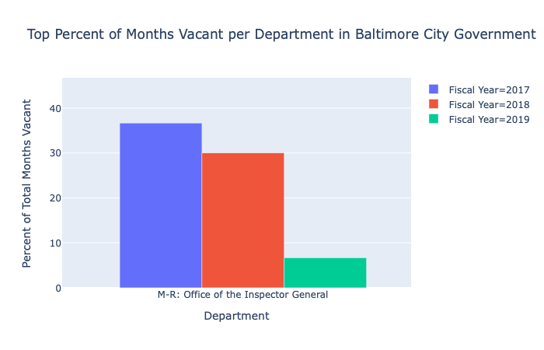
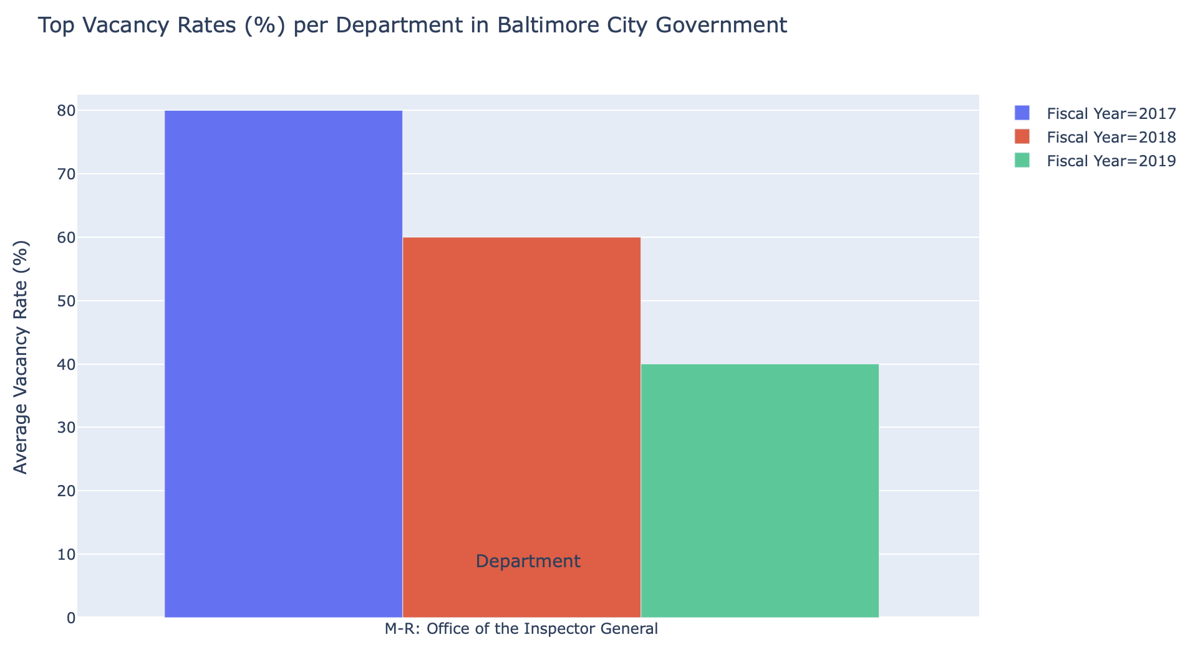
Office of the Inspector General
“The Office of the Inspector General ...lacked a permanent director for 18 months prior to Cumming’s appointment.”
“Since Isabel Mercedes Cumming became Baltimore’s Inspector General in February of 2018, she...hired 9 new investigators.”
2017
2018
2019
http://baltimorebeat.com/2019/06/26/wrath-of-isabel-inspector-general-isabel-mercedes-cumming-on-going-after-waste-and-fraud/
Notes:
Andrea Niu
Once she was apoointed the vacancy rates began to decline. Having a leader in place reduced vacancies.
so transitionary periods where there are no appointed leaders or if there are frequent changes in leadership will promote a culture of job impermanence leading to higher vacancy and turnover

Slide 11

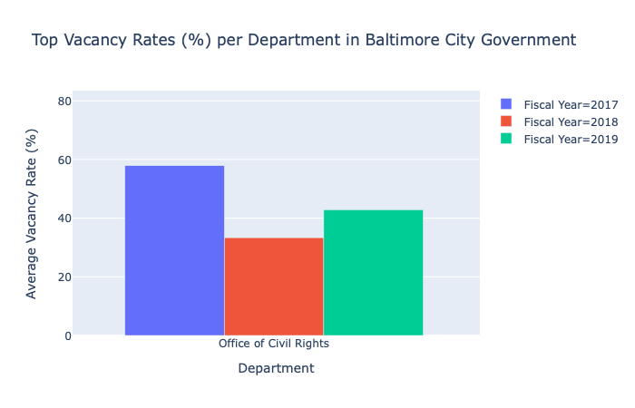
Office of Civil Rights
[Nov 2018] “Baltimore Mayor Catherine Pugh has chosen Darnell Ingram...as director of the city’s Office of Civil Rights.”
“The director’s job has been vacant since May [2018]... Davis said one of Ingram’s first jobs will be to hire some new staff.”
2017
2018
2019
https://www.baltimoresun.com/politics/bs-md-ci-darnell-ingram-civil-rights-20181108-story.html
Notes:
Andrea Niu-19
Having a culture of leaving makes it standard for people to expect job impermanence
One conclusion/finding is that when a new director or dept head is hired, there generally is a significant shift in vacancy rates due to an increase in hiring. Hence it is important that, when a director steps down/resigns, that should be a good substitute in place to avoid letting the department languish without leadership for a long period of time. Having a backup director will allow the hiring process to begin much sooner.

Slide 12
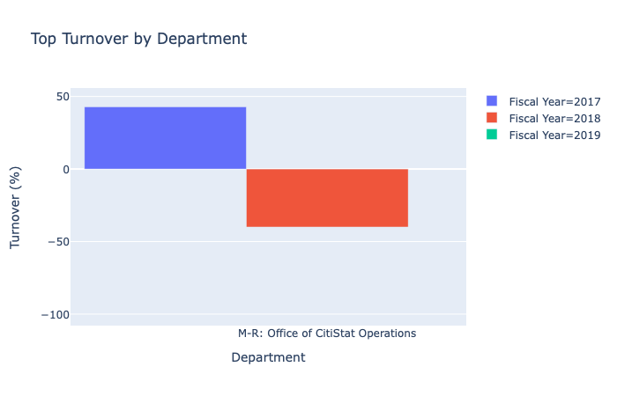
Office of CitiStat Operations
[Jan/March 2015] Director Mark Grimes under fire for “failing to hold regular meetings and produce reports, even as [CitiStat’s] budget has doubled to $1 million.”
[Oct 2015] Sameer Sidh is appointed director of CitiStat.
[Aug 2017] “Kendra Parlock...was introduced as the new person in charge of CitiStat”
*Citistat is now a part of the Mayor’s Office of Performance and Innovation
2017
2018
https://www.baltimoresun.com/politics/bs-md-mark-grimes-leaving-20150819-story.html
https://technical.ly/baltimore/2017/08/10/new-director-named-oversee-baltimores-citistat-office/
Notes:
AndreanIu
Frequent leadership changes with more than 3 leaders over the past 4 years, which is reflected in their poor performance

Slide 13
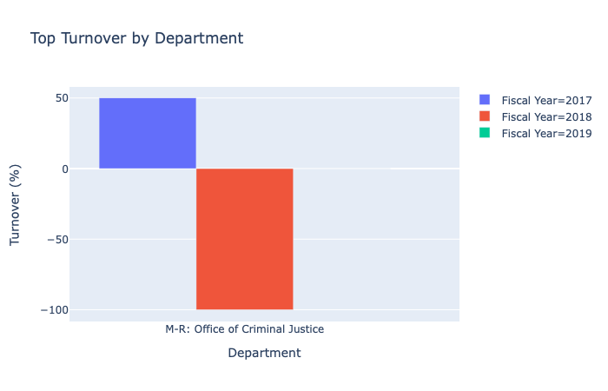
Office of Criminal Justice
[August 2017 - November 2018] Andrew G. “Drew” Vetter appointed but left in join Baltimore County’s executive office
[November 2019] Ganesha Martin left after less than a year
[December 2019] Tamika Gauvin appointed
Lost 50% in 2017, but gained 100% in 2018
Notes:
3 transitions, bad states
18 people
Small department so the % is more alarming, but also losses matter more

Slide 14

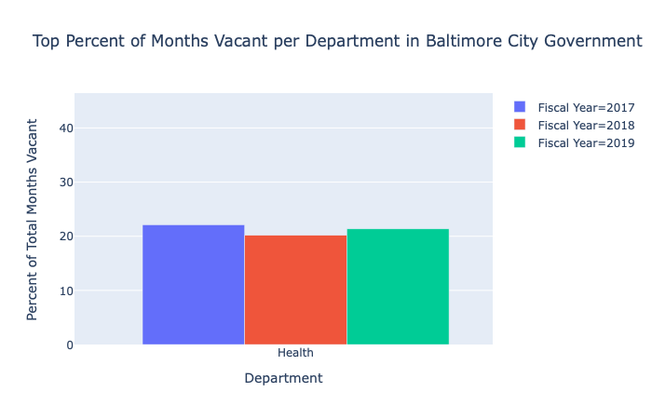
Health
[February 2019] New health commissioner: Dr. Letitia Dzirasa, successor to Dr. Leana Wen.
“Health commissioner is among the city’s most high-profile positions, the department oversees programs to ensure the public’s health”
2017
2018
2019
https://www.baltimoresun.com/health/bs-hs-new-health-commissioner-20190218-story.html?
Notes:
Michele
Similar situation happened in the health department
Also with High vacancy duration
New leadership could affect future turnover rate
https://www.baltimoresun.com/health/bs-hs-new-health-commissioner-20190218-story.html?
Dzirasa, the city’s first African-American woman to serve as health commissioner, follows a modern line of activist-style leaders who have gone to bat for funding or services they believed necessary.

Slide 15
Police Department
The deputy commissioner position has changed hands five times since 2017, with the current head being Michael Harrison.
The department has the highest number of jobs with more than one person occupying it for all years.
At least 250 positions retrained on average
https://www.baltimoresun.com/maryland/bs-md-yir-baltimore-police-1231-story.html
https://www.baltimoresun.com/news/crime/bs-md-ci-tuggler-withdraws-commissioner-20181009-story.html
Notes:
Michele Lan
We recognized that only avg and % didn’t paint the best overall picture so we wanted to look at highest number of jobs with more than one person occupying it for all years

Slide 16
Next Steps (Data Analysis)
Granular Job Title Data
Track reason for departure
Leaving vs. Moving
Analyze people who leave vs. move across depts
Consider position & skill level
Laid off, quit, promotion, etc
Missing Years
Factor in Dept Size
Leadership Data
Deal with depts that are missing data
Weight metrics by dept size
Tag entries with leadership/ dept head
Notes:
Rachel Silverman
Data about job level/skill level
Further analysis based on job title (more granular), as opposed to macro dept scale
Consider how to factor size of department into metrics
Consider how to deal with departments with missing years
Missing data in one month in 2018
New data formatting method
Look into # of people who left city govt for good as opposed to moving to different departments
Include the name of the dpt leader or mayor into data collection to see effect of leadership changes

Slide 17
Solution / Recommendations
Retain department leaders and community culture
(esp for small departments)
Conduct exit interviews and satisfaction surveys,
Find out why people are leaving
Provide realistic jobs previews to find most dedicated,
Have employees review job postings
Provide on-the-job training and opportunity for career growth
Notes:
Michele
Correlation between high changes in leadership and high turnover rates
Retain directors and dept leaders and have a clear plan for their departure
Culture of staying other than leaving after a few years
Dedication to the job
Exit interviews: emphasize confidentiality
We should hear directly from departing employees
Develop concrete understanding of why people are leaving
Have employees review job postings so there’s a clear picture
Emphasize culture and socialization to pick best fit candidates
Training:
Trend of having a career within one organization
Movement throughout it
Overall culture and dedication to the job!

Slide 18
Impact
Improved Productivity and Efficiency
Reduced Training Costs
(~$1,000)
Greater Baltimore city gov’t expertise
Higher Employee Retention
More knowledge-
able employees
Reduced learning curve
Higher quality work/service
Notes:
Avg cost of hiring a new employee = ~$1,000
Better understanding of big picture

Slide 19
Thank You

Slide 20
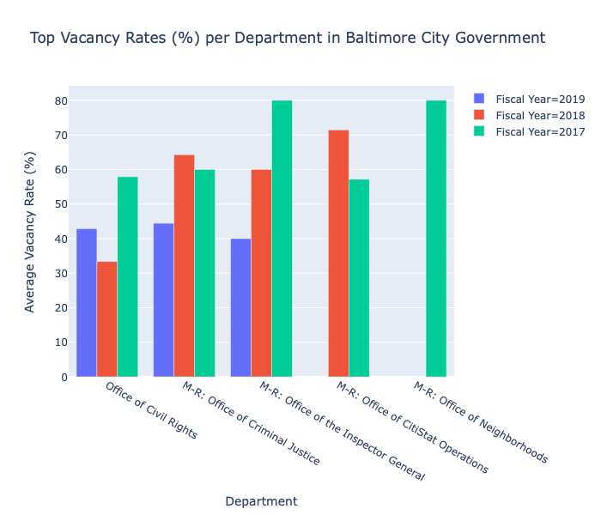
Appendix: Departments with Highest Vacancy Rates
Office of Civil Rights
M-R Office of Criminal Justice
M-R Office of the Inspector General
M-R Office of CitiStat Ops
M-R Office of Neighborhoods

Slide 21
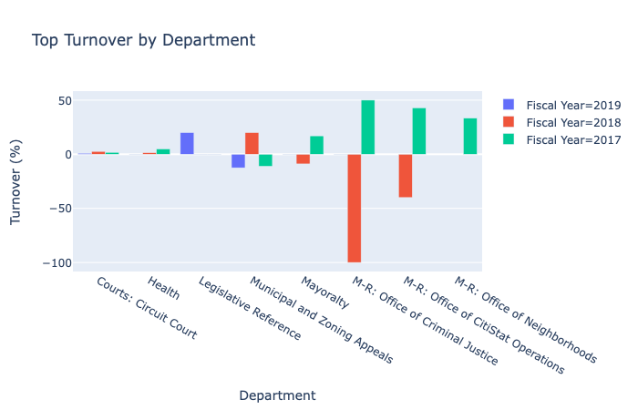
Appendix: Departments with Highest Turnover
Notes:
Considerations>: department size, and the fact that not all of them have data for all years

Slide 22
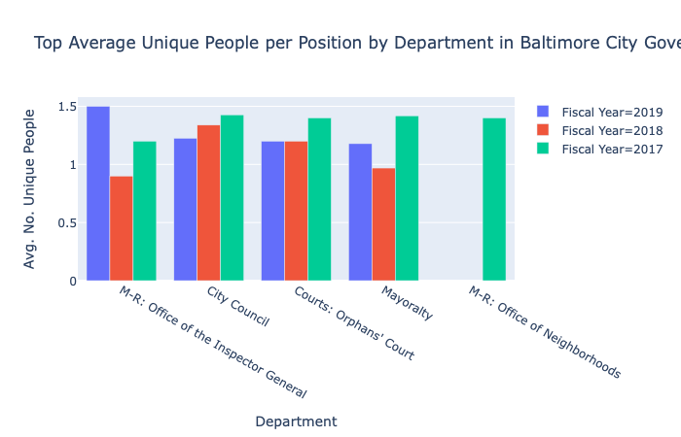
Appendix: Departments with Highest No. Unique People per Position
Notes:
Considerations>: department size, and the fact that not all of them have data for all years

Slide 23
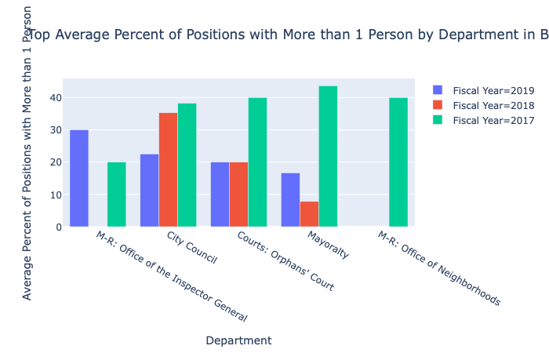
Appendix: Departments with Highest No. Unique People per Position
Notes:
Considerations>: department size, and the fact that not all of them have data for all years

Slide 24
Big concept
Bring the attention of your audience over a key concept using icons or illustrations

Slide 25
You can also split your content
White
Is the color of milk and fresh snow, the color produced by the combination of all the colors of the visible spectrum.
Black
Is the color of coal, ebony, and of outer space. It is the darkest color, the result of the absence of or complete absorption of light.

Slide 26

Want big impact?
Use big image.

Slide 27
Use charts to explain your ideas
White
Gray
Black

Slide 28
And tables to compare data
 | A | B | C
Yellow | 10 | 20 | 7
Blue | 30 | 15 | 10
Orange | 5 | 24 | 16

Slide 29
89,526,124
Whoa! That’s a big number, aren’t you proud?

Slide 30

Let’s review some concepts
Yellow
Is the color of gold, butter and ripe lemons. In the spectrum of visible light, yellow is found between green and orange.
Blue
Is the colour of the clear sky and the deep sea. It is located between violet and green on the optical spectrum.
Red
Is the color of blood, and because of this it has historically been associated with sacrifice, danger and courage.
Yellow
Is the color of gold, butter and ripe lemons. In the spectrum of visible light, yellow is found between green and orange.
Blue
Is the colour of the clear sky and the deep sea. It is located between violet and green on the optical spectrum.
Red
Is the color of blood, and because of this it has historically been associated with sacrifice, danger and courage.

Slide 31
Thanks!
Any questions?
You can find me at:
@username & user@mail.me

Slide 32
SlidesCarnival icons are editable shapes.
This means that you can:
Resize them without losing quality.
Change line color, width and style.
Isn’t that nice? :)
Examples:

